Slide 1

SPACE ALLOCATION TECHNIQUES
Design Optimization Toolset (DOTS)
Nirvik Saha, Ph.D., Post-Doctoral Fellow at Rensselaer Polytechnic Institute
Dennis Shelden, Ph.D., Director of Center for Architecture Science & Ecology, Rensselaer Polytechnic Institute
John Haymaker, AIA, Ph.D., Director of Research at Perkins and Will
Notes:
Hello I am Nirvik and I would like to present my work on the space allocation problem. I am a post doctoral fellow at Center for Architecture Science and ecology at RPI.
Dr. Dennis Shelden is the director of the lab and was my PhD guide at Georgia Tech.
Dr. John Haymaker, is the director of Research at Perkins and Will, who introduced the problem of Space planning which led to this investigation.

Slide 2
Space Allocation Techniques (SAT)
Framework
Integrate
Connected Methods
General class of constrained-problems
NP complete problem
5!=120, 10! = 3.6M+; 14!=87B+; 15!=1.3076744e+12
Floor
Site
City-Blocks
Employed in numerous design processes, across scales
Notes:
Space Allocation Teachniques (SAP) are methods for solving general partitioning problems of 2- or 3- dimensional spaces and allocating program requirements to these sub-spaces.
These problems appear in many architectural and urban design problems.
It is a NP complete and a general solution to SAP remains elusive due to spatial and combinatorial complexity.
This thesis presents novel space allocation techniques to solve this general class of problems.

Slide 3
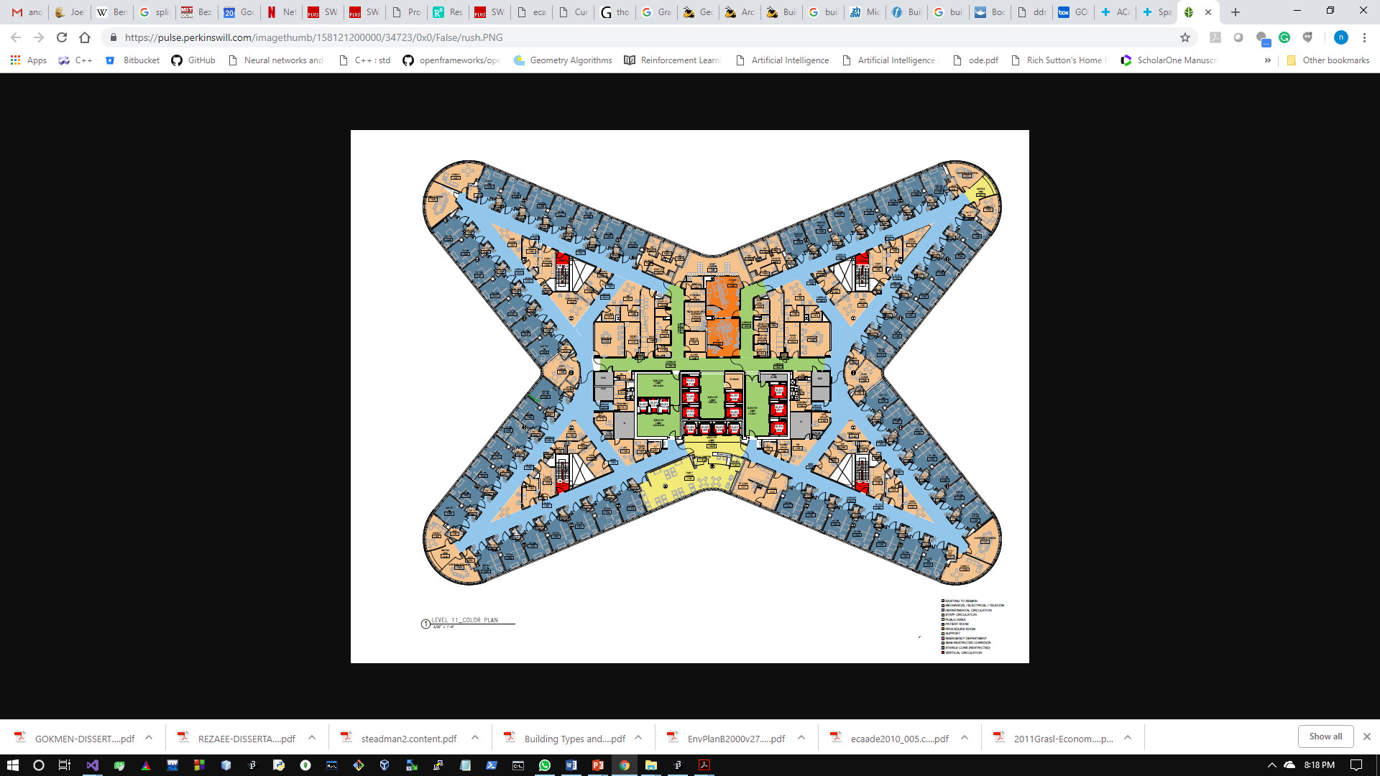
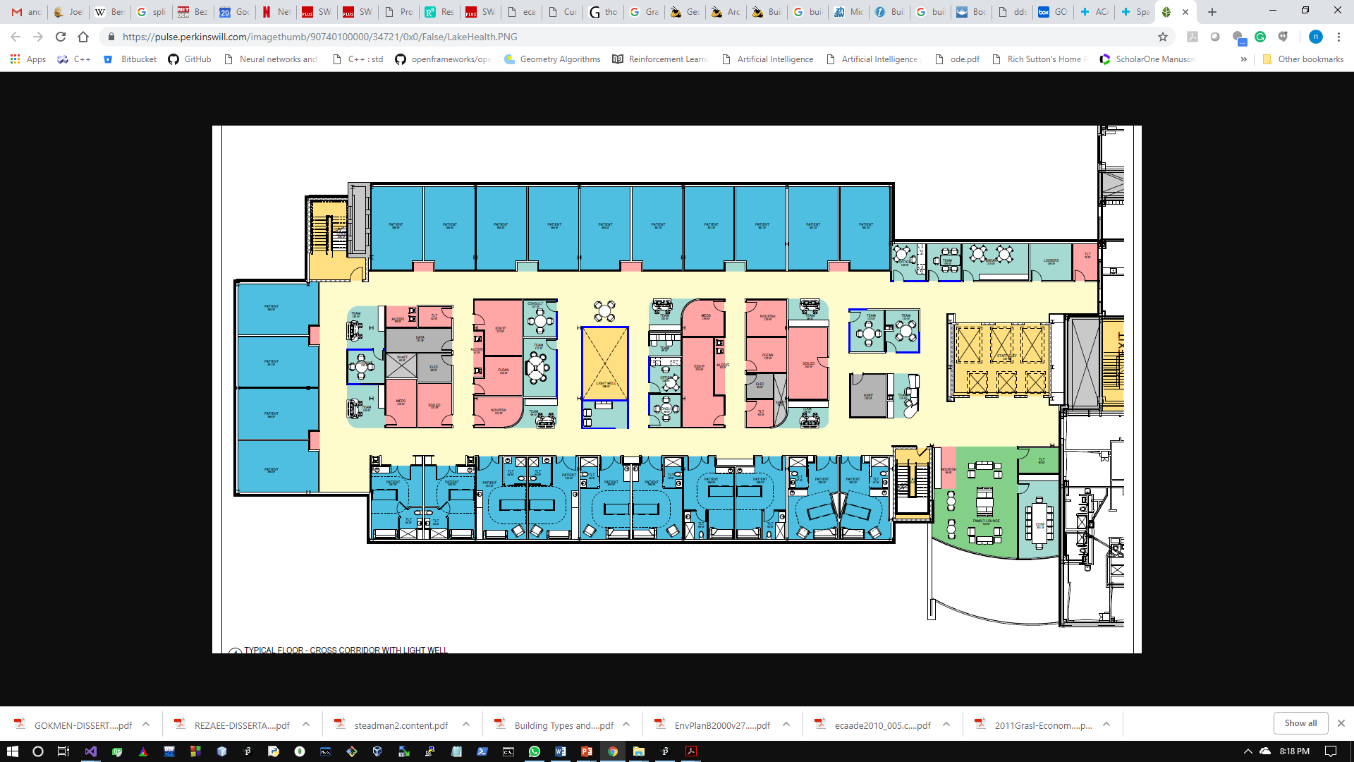
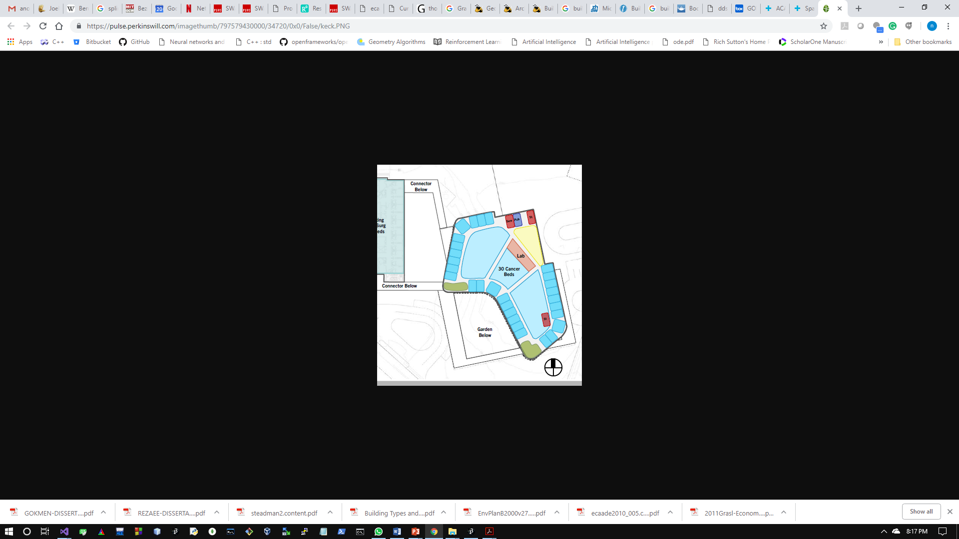
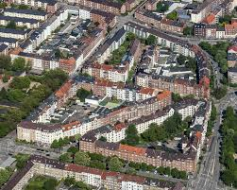
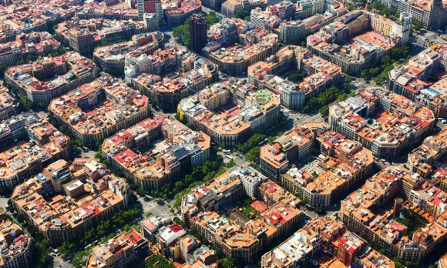
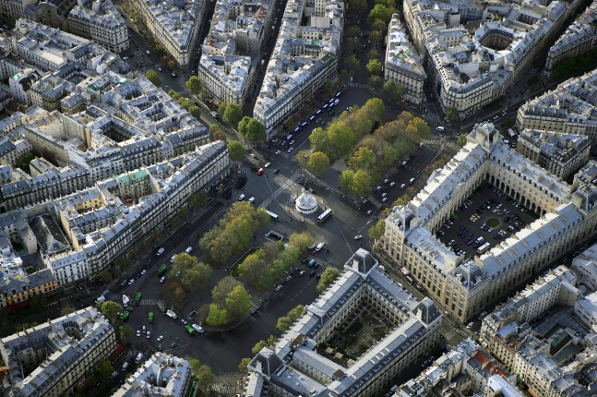
Observations
Collection of Patterns, Generalize – form / task
Geometric forms
Optimization techniques
Algebraic forms + Reinforcement Learning
Generalize geometric formulation
Simulate Data
practically impossible to collect data before design
Patterns in organization of spaces: i) along the periphery ii) subdivision of internal region.
Building floor plans
Satellite images of Barcelona, Paris, and Berlin
Notes:
In this paper, we describe geometric methods that generate commonly used shapes in design including rectangles, curves, general polygons, open curve segments, and composite shapes.
We propose that, to a large extent, the geometry of architectural spaces can be generalized by formulating spaces along a curve and and internal subdivision of the bounding curve.
These methods for geometric formulation are subsequently integrated with the optimization algorithms.
Optimization process refines the topological structure of a layout. It is based on well-known constraints of orientation, adjacency, proximity, and area constraints.
The optimization algorithm operates upon the attributes of abstract representation of the spaces and the layout is iteratively improved by evaluating the effect of an action and tracking the score.
Circulation between spaces is achieved by procedural methods to minimize travel distance and the number of circulation-segments while maximizing the overall connectivity.

Slide 4
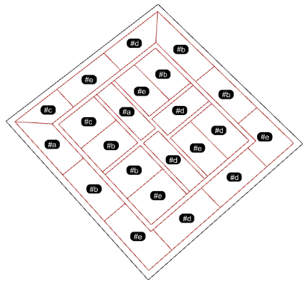
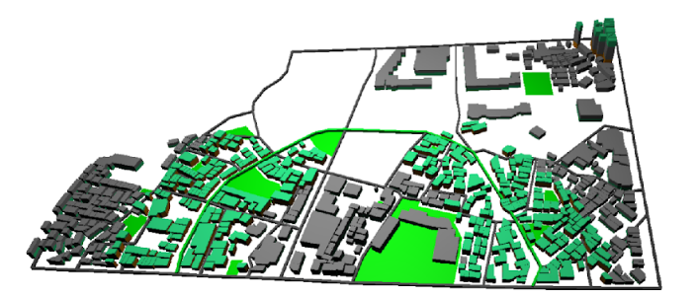
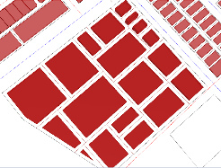
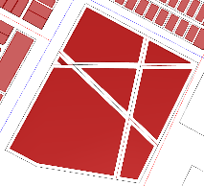
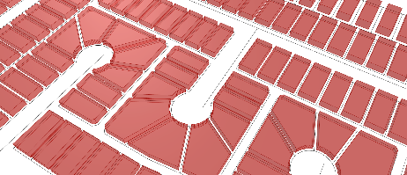
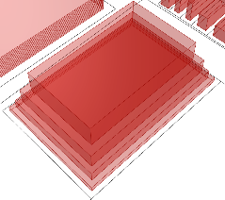
Reinforcement Learning
Environment
Agent
State
Action
Reward
Environment
Action-Value Function
Policy
Q-Learning
Methods
s
Initial State
P
Policy
a
Action
p
Probability
Reward
r
s’
New State
Floor Plans
Site Plan & massing
Space-Activity Networks of City-blocks
Notes:
WE are going to use agent-environment interaction based on MDP
The environment is the set of all possible locations, constraints, evaluation mechanisms. The locations are internally represented as states and used as arrays.
The agent is an algorithm that assigns space to each location.
Policy is the map of the entire set of states to spaces to activities.
Learning is the mechanism that allows an agent to predict the value function without performing the actual action.
--------------------------------------------
The topological requirements are satisfied by the sequential decision-making, using model-free methods where the action-value function is determined.
– Array of SPACE map to Array of locations and activity to the space.
The state = all the spots in the layout that can be occupied by a space
Action is the placement of space to a location- algorithm decides to place a space at a location
Reward is the numerical value assigned to the action taken by the agent – based on the constraint
Action-value function is the cumulative award given to the agent for decisions made.
Policy is the map of the entire set of state-space

Slide 5
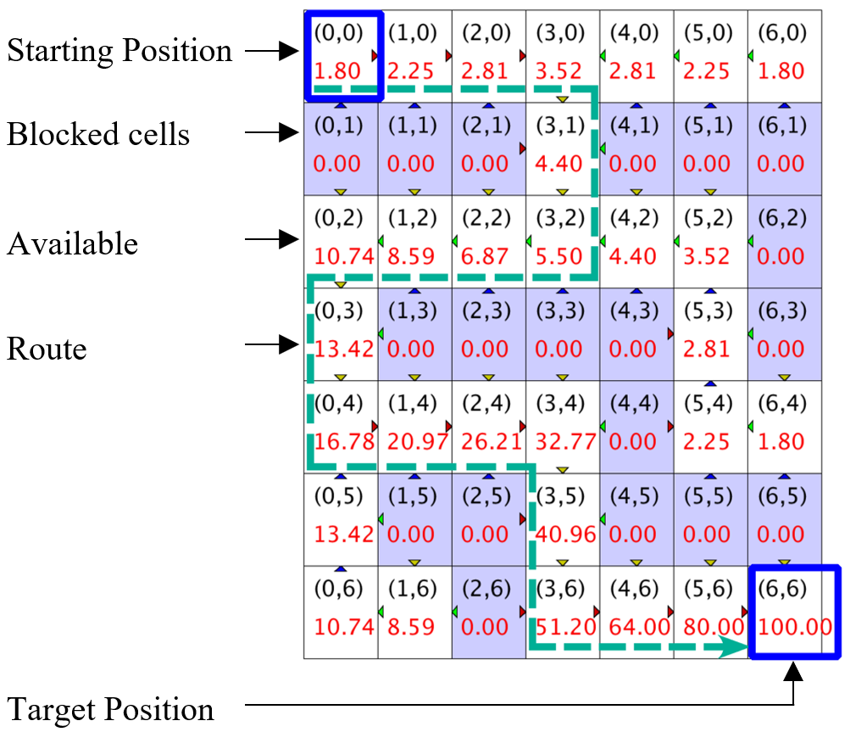
Illustration of Reinforcement Learning
Initialize Q matrix with elements set at 0
States (x,y) | 0 | 1 | …6
0 | 0.0 | 0.0 | 0.0
1 | 0.0 | 0.0 | 0.0
…6 | 0.0 | 0.0 | 100.00
Discounted rewards Reward: R(s’,a) = R(s,a)+∑_{(i=1)}^{T}γ^{(i-1)}R_{i} (where 0<γ<1, let γ=0.8)
Set of states s_{i}: {(0,0, (0,1), (0,2), …, (6,5), (6,6)}
Set of actions a_{i}: {up, down, left, right}
Updated Q matrix
States (x,y) | 0 | 1 | 2 | 3 | 4 | 5 | 6
0 | 1.80 | 2.25 | 2.81 | 3.52 | 2.81 | 2.25 | 1.80
1 | 0.00 | 0.00 | 0.00 | 4.40 | 0.00 | 0.00 | 0.00
2 | 10.74 | 8.59 | 6.89 | 5.50 | 4.40 | 3.52 | 0.00
3 | 13.42 | 0.00 | 0.00 | 0.00 | 0.00 | 2.81 | 0.00
4 | 16.78 | 20.79 | 20.21 | 32.71 | 0.00 | 2.25 | 1.80
5 | 13.42 | 0.00 | 0.00 | 40.96 | 0.00 | 0.00 | 0.00
6 | 10.74 | 8.59 | 0.00 | 51.20 | 64.00 | 80.0 | 100.00
Notes:
The set of space-activity relationships is maintained as a matrix – table.
We can use dynamic prog, McMC, epsilon-greedy algorithms, neural nets, to explore state-space-activity relations and update the table.
So when the iterations are paused, the table can be parsed to reveal the best structure.
----------------------------
This slide explains the Q-learning algorithm with an intuitive path-finding algorithm.
The agent must select the quickest route through the while cells and the blue cells are blocked.
Suppose the constraints are updated and the iterations are resumed- then the change in constraints will be reflected in a part of the matrix.
Therefore subsampling can be used to update the solution rather than starting the iterations all over.
In the case of well-known heuristics such as genetic algorithms, these features are not available, and it requires a complete set of iterations before an appropriate structure is revealed.

Slide 6
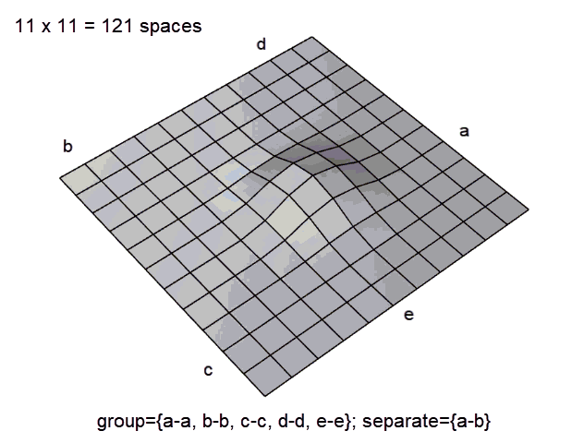
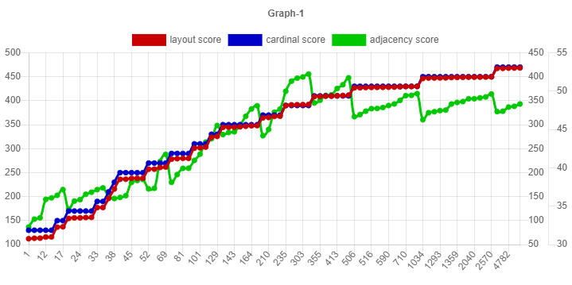
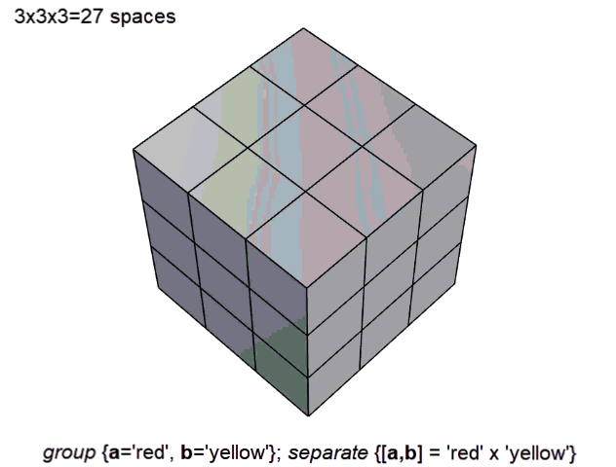
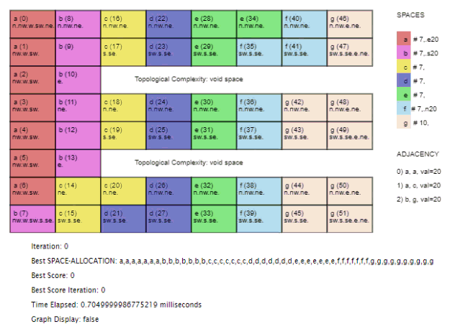
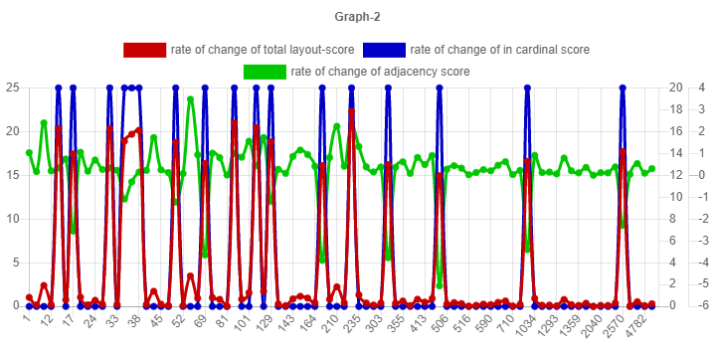
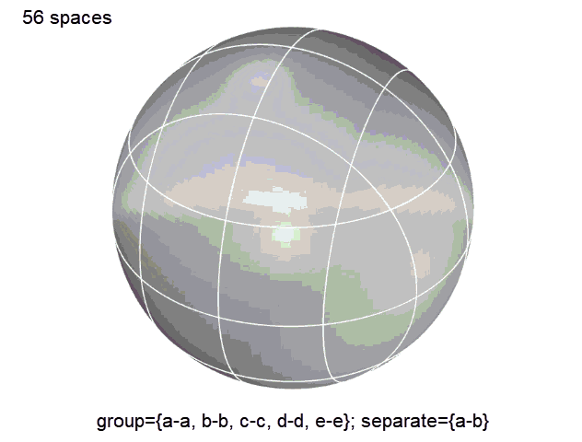
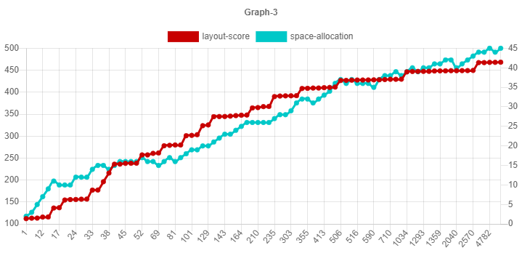
Problem Formulation
@ https://dots-ai.herokuapp.com/
Constraints in a nutshell
Adjacency
a-a,
a-c,
b-g
Orientation
a-> east
b-> south,
f-> north
Graph 1 :
layout-score
orientation-score
adjacency-score
Reinforcement Learning
Graph 2 : rate of change:
layout-score
orientation-score
adjacency-score
Graph 3 :
layout-score
change in layout
Notes:
This slide shows the application of an optimization algorithms to a design scheme.
The constraints are based on adjacency and orientation.
ON LHS: There are 52 spaces and 9 constraints, and we see that in a few seconds, the solution is achieved.
The process of agent environment interaction with McMC is illustrated.
The advantage of maintaining the transition matrix is the ease of updates when constraints are changed or to retrieve best results when the process is paused.
Graph 1 shows that the layout score closely follows the adjacency and orientation scores, all three scores improve steadily over time.
Graph 2 shows the layout score in comparison to cumulative deviation in layout-string
Graph-3 shows the rate of change or gradients of overall score, adjacency and orientation score. The orientation spikes drastically and affects the rate of change of layout score. Although adjacency score changes frequently, it does not have as much effect because net adjacency variation is low whereas the orientation has a much greater effect because at once the entire value is added to the layout.

Slide 7

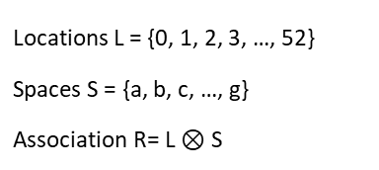
Problem Formulation
Locations L = {0, 1, 2, 3, …, 52}
Spaces S = {a, b, c, …, g}
Association R= L $⊗$ S
Each Cell:
name of space
index
orientation
Cell
Computational Process
pathfinding
formulation
agent-environment
sequential decisions
SAP problem
SAP process
SAP analysis
Concisely, the application of Q-Learning
Discounted rewards Reward: R(s,a) = R(s,a)+∑_{(i=1)}^{T}γ^{(i-1)}R_{i}
After m x n iterations Q = Scoring & Policy: best move for each state
Set of states s_{i}: {(0,0, (0,1), (0,2), …, (6,5), (6,6)}
Set of actions a_{i}: {up, down, left, right}
# Iteration: 1013 Layout Allocation: a,e,c,d,g,f,g,b,c,e,b,c,e,b,b,d,e,c,e,b,a,f,d,c,c,d,d,d,a,e,a,e,g,g,c,d,a,f,a,f,g,f,g,f,a,g,b,g,b,g,f,g adjacency score: 385.17978859692 orientation score: 171 Total Score: 556.1797885969199
What is an iteration?
Exploration: McMC
What is calculated in a generation?
State-Action-Value function
Transition Matrix
{constraint_Id: 1, value to layout: -0.1130466837888443}
{constraint_Id: 1, value to layout: -0.09701425001453319}
{constraint_Id: 0, value to layout: -0.07327433054473118}
Notes:
Once again, it is a mapping of spaces to location & activities to spaces
A system for rewards is setup based on bellman equation.
it is a case of Q-learning with McMC
An overall score is computed for the generation. Contribution of constraints are measured. So if a constraint does not contribute much, it will be ignored over time.
Also, if a space is found algorithm actively seeks a better coupling in the neighborhood.

Slide 8
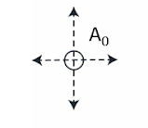
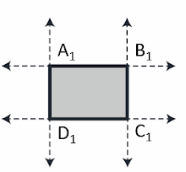
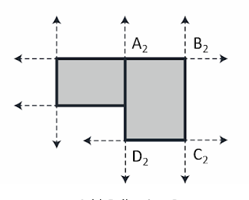
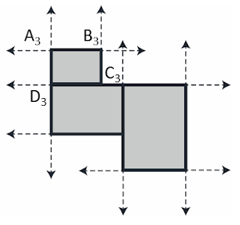

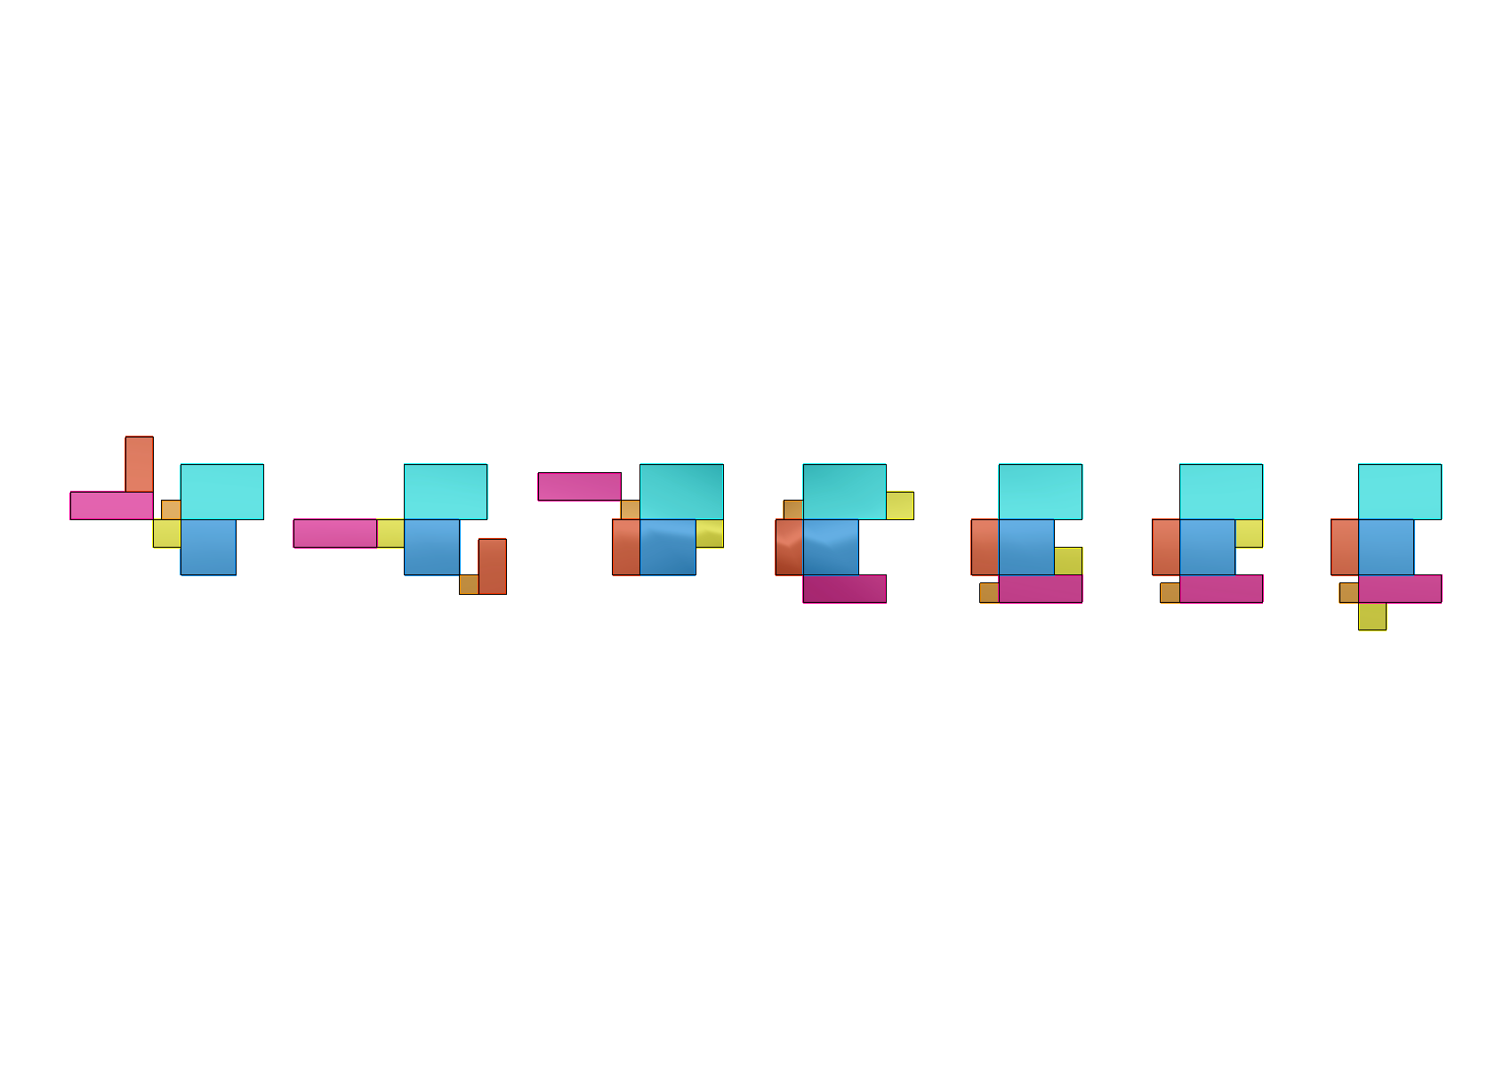
Formulation 1
Name | Length | Width | F1 | F3 | F5
F0 | 100 | 100 | 10
F1 | 70 | 70 |  | 10
F2 | 100 | 200 |  | 10
F3 | 300 | 100 |  |  | 10
F4 | 300 | 200 |  |  | 10
F5 | 200 | 200
Growing a configuration:
Constraints
f0
f1
McMC Iterations
f2
f3
f4
f5
f5
f0
f0
f0
f0
f0
f2
f0
f4
f0
Representation
f3
f5
f4
f4
f5
f3
f5
f5
f5
f4
f3
f1
f3
f2
f1
f4
f1
f2
f1
f2
f4
f2
f3
f1
f1
f2
f3
f3
f4
f5
f2
f1
Backtracking
f5
f0
f0
f5
f0
f0
f0
Missing Adjacency Relation
f3
f3
f5
f1
f1
Achieved
f1
f1
f1
f3
f1
f3
f1, f3, 8
f3, f5, 4
f0, f1, 7
f1, f3, 8
f3, f5, 4
f0, f1, 7
f3, f5, 4
f0, f1, 7
f1, f3, 8
f0, f1, 7
f0, f1, 7
No Error
Notes:
The algorithms can be applied to geometric-formulations. Here, for instance spaces are incrementally added and a formation is generated by a process of accretion.
Using the same input setup for adjacency but the area of the spaces are also included and really, any number of constraints can be added – for instance compactness was demonstrated with this algorithm.
The backtracking is shown where the system searches for unmet relations and tries to fulfil them in the subsequent iterations.
This is another reason for using these algorithms because they search for ways in which missing relations can be best addressed.

Slide 9
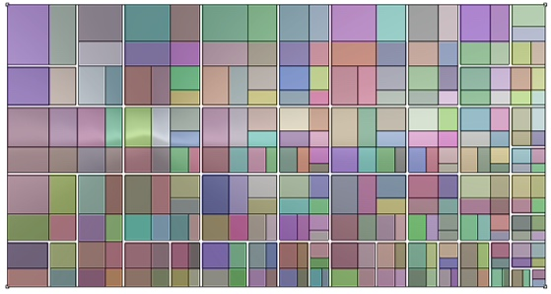
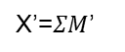
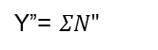
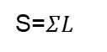

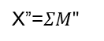
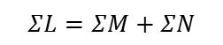
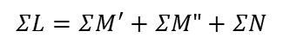
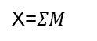
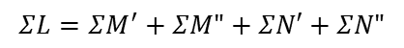
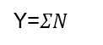
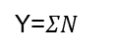
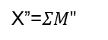
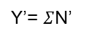
Formulation 2
Equivalence between requirements and the geometric operations
Generate Circulation
Binary Partition
Requirements - partitions
Geometric Equivalence
Area=$ΣL$
L={a,b,c,d}
S=$ΣL$
L={a,b,c,d}
$$ΣL=ΣM+ΣN$$
M={a,b}
N={c,d}
Y=$ΣN$
X=$ΣM$
S=$ΣL$
L={a,b,c,d}
M={a,b}
N={c,d}
X’=$ΣM$’
Y=$ΣN$
$$ΣL=ΣM^{′}+ΣM"+ΣN$$
M’={a}
M”={b}
X”=$ΣM"$
S=$ΣL$
L={a,b,c,d}
Y’= $Σ$N’
$$ΣL=ΣM^{′}+ΣM"+ΣN′+ΣN"$$
M={a,b}
N={c,d}
X’=$ΣM$’
M’={a}
M”={b}
N’={c}
N”={d}
X”=$ΣM"$
Y”= $ΣN"$
S=$ΣL$
very large layouts
Notes:
The SAP is addressed by formulating a homeomorphic relation between geometric and topological requirements.
As the area requirements are split, there must be a correspondence with the geometric form.
The partition is controlled by a set of vectors where they provide the direction of the segment.
The topological structure of the layout is used to generate variations. So, the sub-tree can be extracted and placed at a different node to generate the variations.
This is illustrated by the language O-origin, L-left and R-right.
The circulation is generated by greedily selecting segments until all spaces are connected
-------
Basically, the geometric formulation can be reduced to a string notation and this string can be altered to generate the variations,.
From the center of a space, the shortest line segment to intersect a partition can be determined in quadratic time.
partitions are extracted, greedily, such that all spaces have a partition.

Slide 10
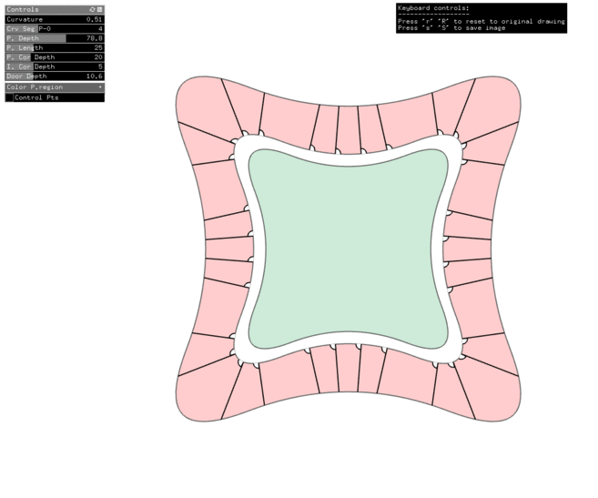
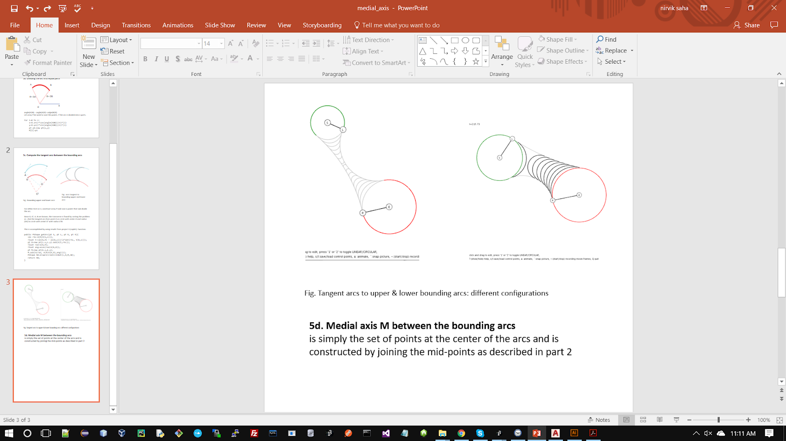
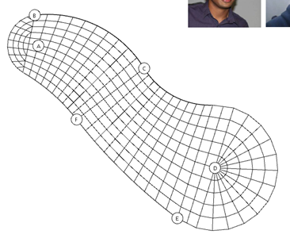
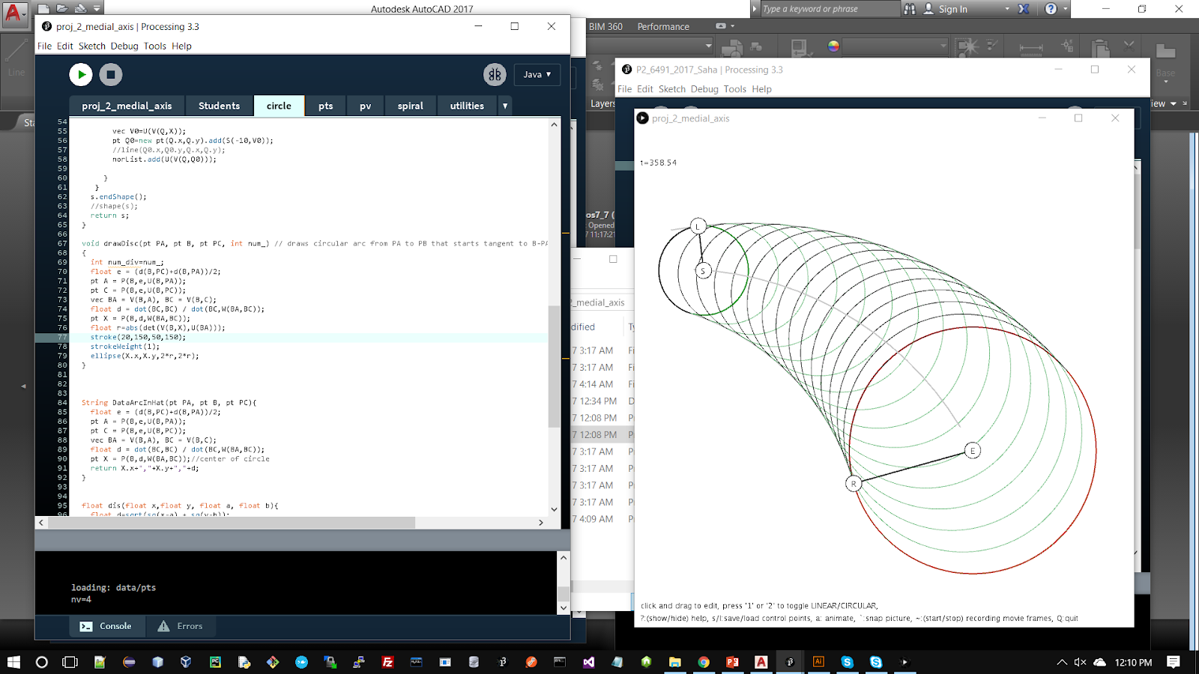
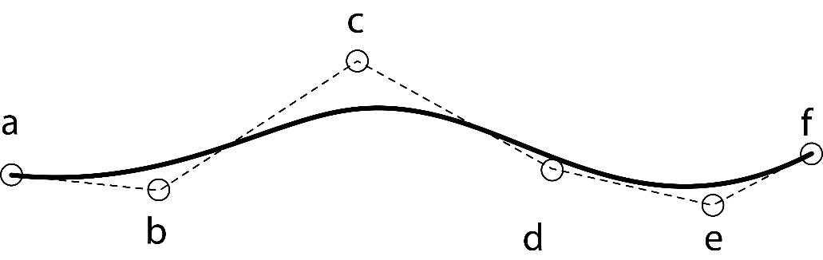
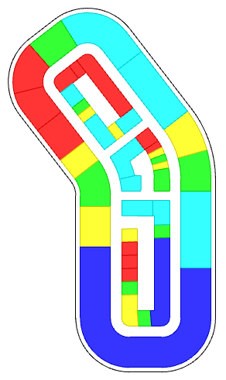
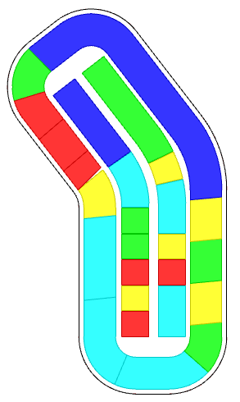
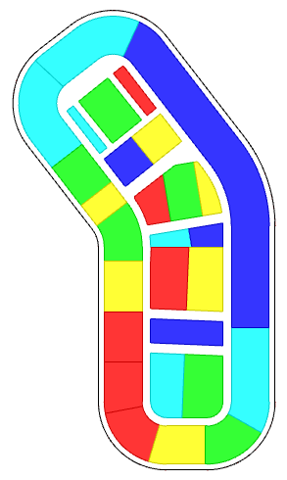
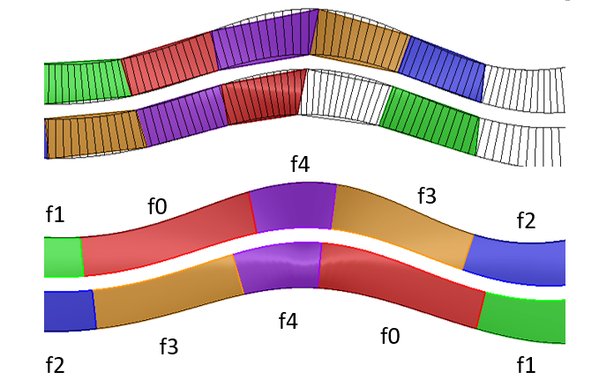
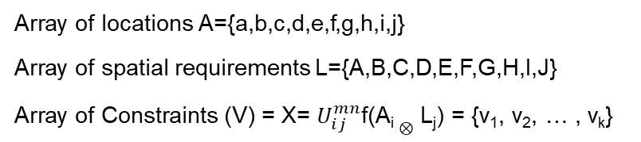
Formulation 3
Using Transformations & Discretization of region in a curve
Array of locations A={a,b,c,d,e,f,g,h,i,j}
Array of spatial requirements L={A,B,C,D,E,F,G,H,I,J}
Array of Constraints (V) = X= $U_{ⅈj}^{mn}$f(A_{i} $⊗$ L_{j}) = {v₁, v₂, … , v_{k}}
Seamless transformations:
Bernstein polynomial basis recurrence relation
f(t) = Σ_{i=0}^{n} (^{n}C_{i}) (1-t)^{n-i} t^{i}
spaces | Area | Depth | Number | rgb | f0 | f1 | f2 | f3 | f4
f0 | 1000 | 100 | 2 |  |  |  |  | 50
f1 | 300 | 100 | 2 |  |  | -50
f2 | 500 | 100 | 2 |  |  |  | -50
f3 | 850 | 100 | 2 |  |  |  |  | 50
f4 | 350 | 100 | 2 |  |  |  |  |  | 100
Discretization:
Medial Axis Transform
Combined Patterns
peripheral
longitudinal
transverse
Notes:
Apart from accretions and partitions, architectural patterns can be generated procedurally
Spaces along a curve
or off the medial axis or its transverse.
Seamless transition between curves & polygons is achieved by using an algebraic expression of the curve

Slide 11
Integrated data structures
Connected Methods
Design problems are nested
SAT
Optimize
SAT Generate
Models (M_{0-n})
Design problems
Geometric Forms
Organize relationships
Model-1
Model-2
SAP
workflow
workflow
Linked- multiple models
Notes:
In this thesis, a Space Allocation Problem is thought of as a set of tasks which can be mapped to computable models.
These models call a set of methods from a common pool of SAT.
By providing an integrated framework, the designer can combine models in various ways to generate unique solutions.
We integrated space allocation techniques (SAT) to
generate architectural schemes of diverse functional and geometric typologies by distributing
spaces from a point, along a curve, or by partitioning a closed curve.
Simultaneously, reinforcement learning is used to optimize user-defined measurable attributes of the layout
such as outer boundaries, adjacencies, the distance between spaces, area, circulation, FAR distribution, and orientation

Slide 12
Explicit Design Process
Exploration
Semi-automation
Framework
Integrated Framework: novel SAP using permutations of process models
SAP (P_{i})
SAP (P_{i+1})
SAP (P_{i+1})
SAP (P_{n})
DESIGN PROBLEM
Design Optimization Tool Set (DOTS)
FRAMEWORK
model-1
model-2
model-n
USER ACCESS – process models
BLACK-BOX ALGORITHMS
SAT₁
SAT₂
SAT₃
SAT₄
SAT_{n-2}
SAT_{n-1}
SAT_{n}
Notes:
In this thesis, a SAP is thought of as a set of tasks which can be mapped to computable models.
These models call a set of methods from a common pool of SAT.
By providing an integrated framework, the designer can combine models in various ways to generate unique solutions.

Slide 13
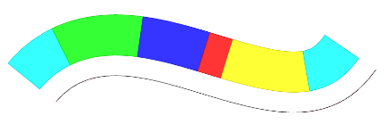












Framework
Symbol
Description
Illustration
Symbol
Description
Illustration
Plots rows of spaces based on geometry & adjacency given an open curve
Generates equal partition of spaces along the periphery of a given curve.
Creates the circulation for the partitioned region
Plots two rows of both geometry & adjacency for an open curve
Plots a 2D grid of spaces and organizes the activities
Plots geometry & adjacency for a given closed curve
Split a Curve into a core and quadrants
Partitions a given region into spaces and organizes the activities
Generates exact geometry of spaces by partitioning a given curve
Notes:
IDF, short for integrated design framework is used to test the proposed SAP solutions
These components are based on the patterns commonly used in architectural design
IDF is an open framework and more modules can be added.

Slide 14














Framework
Symbol
Description
Illustration
Symbol
Description
Illustration
Given a site, generates parcels along the periphery of the region
Basic Tower: Extrusion based on FSR, setbacks, etc
Sub-divides the region into parcels - for massing
Extrusion based on FSR, setbacks, step-backs, variable heights, etc.
Creates the circulation for the partitioned region
Generates courtyard typology based on fsr, setback. etc
Generates internal partitions and eliminates a region from the parcels
Selective extrusion of the podium
Given an internal polygon, generates parcels that correspond to the sides
Large-scale FSR allocation from streets for any given parcel geometry
Given a site and circulation, generates the parcels for massing or subsequent operations
Notes:
The components shown in the slide perform various massing typologies and parcellations of the site.
The parcellation of the site use the same geometric formulations without the optimization criteria shown before.
So, space planning algorithms can be used to generate and exactly place each requirement on the site.

Slide 15










Framework
Symbol
Description
Illustration
Symbol
Description
Illustration
Allocate footprints in a curve for Site Feasibility studies
Generate grid-circulation in a region
Allocate activities to floor plates vertically in buildings for Site Feasibility studies
Generate parcels to accept Fsr distribution
Organizes the activities to index of spaces for any given geometry of spaces - multiple sources (only optimization).
b,d,a,e,e,d,
c,a,b,c,b
Fsr distribution across Parcels from >1 points
Fsr distribution across parcels from curves and points
Notes:
Then there are specific problems such as site-feasibility studies and generating attractor-based FAR distribution along with grids & massing.
These are well-known expressions and included for the sake of completeness
In addition to these modules, there are a number of utility functions for geometry manipulation, data structures and transport of data over the internet

Slide 16








Framework
Result of operations
start
DOTS notation
end
Notes:
All this is captured in the IDF framework which is developed as user friendly plugin for designers.
The components were integrated with proprietary software using their C# API and the codebase reference several c++ libraries for novel geometry processing and optimization algorithms.

Slide 17



Optimization Problem Formulation
Geometry Inputs
Name | Key | Area |  | Number
name_A | a | 500 |  | 2
name_B | b | 500 |  | 4
name_C | c | 1500 |  | 2
name_D | d | 750 |  | 4
name_E | e | 2000 |  | 5
Adjacency Inputs
Name | Key | a | b | c | d | e
name_A | a | 100 |  | 10
name_B | b |  | 10
name_C | c | 10
name_D | d |  |  |  | -50
name_E | e
Attract:
a-a
a-c
b-b
e-e
Repel:
d-d
Inputs
Initial Configuration
Optimization
Updated result

Slide 18






Semi-automation
1. Change constraints during the process
2. Change geometry
Name | Key | a | b | c | d | e
name_A | a | -100
name_B | b
name_C | c
name_D | d
name_E | e
Repel:
a-a
Generalize / flexibility
Name | Key | a | b | c | d | e
name_A | a | 100 |  | 10
name_B | b
name_C | c | 10
name_D | d
name_E | e
Attract:
a-a
a-c
3. Memory functions
Name | Key | a | b | c | d | e
name_A | a | 100 |  | 10
name_B | b |  | 10
name_C | c | 10
name_D | d
name_E | e
Attract:
a-a
a-c
b-b
Attract:
a-a
a-c
b-b
Repel:
a-a
Name | Key | a | b | c | d | e
name_A | a | 100 |  | 10
name_B | b |  | 10
name_C | c | 10
name_D | d |  |  |  | -50
name_E | e
Notes:
Next the idea of semi-automation is illustrated where the user changes the inputs step by step in an external excel file and the IDF parses the inputs & generates the solution.

Slide 19














Space Planning
Explicit Design Process
DOTS notation
Original Scheme without color-coding | Schema represented as zones of partial ordering | Zones:
 |  | A: Peripheral B: Corner Zones C: Central Zones D: Core
DOTS notation
<4 threads>
List of requirements: Neuro Patient Room, Patient Room, Ada Patient Room, Conference, Training Room, Neuro Monitor Room, Reading, Interview Room, Ptot Therapy, EVS, Consult, Seating Area, Family Lounge, Staff Lounge, Workstation, Meds, Clean Supplies, Staircase, Nour, EVS, Linen, Shared Office, Public Tlt, IS, Dir Office, Trash Recycle, Pts, Elec, Treatment Room, Respite Room, Food Gallery
<4 threads>
Notes:
An application of space planning is illustrated here which shows how to develop complex solutions
and once the IDF workflow is developed, it can be applied to other geometries with constraints of a different project.
this is being addressed as independent explorations where the initial conditions are changed.

Slide 20




Extended Capabilities: Site Feasibility Study
DOTS notation
Building Details, proximity / distance matrix
Name & Identification |  | Geometric Constraints |  |  |  | Distance Constraints
Name | Key | Number | Footprint Area | Fsr | Ratio | a | b | c | Color
name_A | a | 2 | 100 | 0.5 | 0.75 | 12 | 12 | 5
name_B | b | 1 | 100 | 0.2 | 1.25 | 5
name_C | c | 3 | 100 | 0.2 | 0.75 | 5 |  | 12
name_D | d | 2 | 100 | 0.35 | 1.25 | 5
The distance matrix performs is similar to the adjacency matrix, unspecified values are assumed as 0
Activity Details
Identifier |  | Location Constraints |  | Building Identifier
Name | Key | Percentage | Height | Parent | Parent | Parent | Parent | Color
name_P | p | 20 | 50 | a | b | c | d
name_Q | q | 70 |  | a | c
name_R | r | 10 | 200 | a | b
Since the activity is allocated after placing the buildings, the parents are used to identify the building.

Slide 21




Extended Capabilities: Large-scale design problem
Nodes: building, squares, parks, etc.
Edges: Streets, roads, pedestrian path, etc.
Places
Node type: GCN
Node type: NCN
Node type: RCN
Node type: EVAC
Grid
Network
Circulation
Buildings / Space Allocation
from region enclosed by a curve
Connect nodes with edges
Edges- TYPES of geometry of streets, roads
centrality, dispersal, betweenness, intersections
Live
Shop, recreate
Work
Exit
Edge type: Green
Edge type: Neutral path
Edge type: Road
Edge type: Intersection
Edge type: MST path
Edge type: Evacuation
Connectivity,
Interactions

Slide 22



Networks of graphs & nodes
web-based solver
Constraints: cost functions for centrality, betweenness, attraction, proximity between nodes & FAR of each
Interaction between Nodes
Node type: GCN
Node type: NCN
Node type: RCN
Node type: EVAC
Live
Shop, recreate
Work
Exit
Interaction between sets of nodes
Edge type: Green
Edge type: Neutral path
Edge type: Road
Edge type: Intersection
Edge type: MST path
Edge type: Evacuation

Slide 23



Interoperability for designers
Cloud - mLab, Heroku (web)
https://dots-web.herokuapp.com/
Constraints
Design Alternatives
Energy Plus Simulation (honeybee)
Energy
Solar harvesting Potential (ladybug)
Daylighting
Radiance (honeybee)
Openness
Sky view factor (ladybug)
Evaluate Solutions
Rhino3d, Grasshopper
https://github.com/nirvik00/DOTS
Dynamo/Revit (BIM)
https://github.com/nirvik00/DotsDynamoDll
Rezzae et. al., 2020;
Notes:
the IDF is not an isolated framework. It has components to transmit geometry and data over the internet and connect to software such as dynamo-revit or rhino on a different computer.
It can also be connected to live-web-applications on the cloud as shown here.

Slide 24

Conclusion
Notes:
Several features of an integrated framework are identified to evaluate process-models and enhance their applicability in the development of architectural schemes.
The features target various aspects of model-manipulation concerning the generalization & optimization
The features lead to the development of semi-automated design process, which is preferred in an artistic field such as architecture and urban design, where constraints are flexible
Applications at present include scales of floor plans, site plans, site feasibility studies, city-blocks and scales in between- as well as their geometric and topological variants.

Slide 25
Future Work
Data-driven, “thoughtful”
design solutions
SAT
Sources of Information & Data
Recommendation Systems
process guidance
inference-based
Complimentary Platform
integrated logic
explicit design workflows
Semi-Automation
Performance Measurements
Spatial-temporal data
Origin-destination studies
Real time data
FOR a given scheme: energy analysis, daylighting,
of tourists, places of interest, visited,
from IoT devices and smart city platforms
GIS, mobile, tracking devices
local spikes in travels
amenity requirements
Notes:
We have proposed a way to develop design solutions, which have inbuilt logic and allow designers to focus on design constraints and rapidly explore alternatives
The designer is not restricted to just one platform but can jump from rhino-revit or expose to the client via web interfaces
Specifically focused on architecture and urban design not just as shapes or geometries but as objects with abstract definitions of physically significant properties
The prototype can be enhanced by additional geometric modules
By incorporating mechanisms for additional design processes
By considering various sources of data and information and suitably altering the software architecture.
Implication is that there are vast sources of information from simulation models to spatial temporal – tourist data, to iot platforms that can be used to develop design constraints.
A generative process is required to organize this information and develop spatial solutions very quickly and allow designers to reiterate and test out various hypotheses.
-----------------------------
DONT READ
-----------------------------
This research is informed by prior and contemporary research and the fields or algorithms provided absorb the fields that are used by designers to study or develop metrics for a place.
We directly tie up various fields in study of urban places and streets – for instance with shortest path algorithms or centrality & dispersal, depth first-breadth first search, etc, apart from bylaws and provision for prescriptive laws.
The explicit design process provided by the models allow designers to reiterate when new information is available and the spatial-model can be easily changed with minimum effort.

Slide 26
Technologies
Dots Plugin for Rhino/Grasshopper | https://github.com/nirvik00/DOTS
Dots-web (cloud service) | https://dots-web.herokuapp.com/
Dots Plugin for Dynamo BIM | https://github.com/nirvik00/DotsDynamoDll
Plugs-web solver | https://plugs-web.herokuapp.com/
Reinforcement learning illustrated | https://dots-ai.herokuapp.com/
Applications: Games using AI/ML | https://ai4dots.herokuapp.com/
Frameworks & Programming Languages used | C++, C#, Python, JS, Openframeworks, Processing, Three.JS, Rhino-common API, Dynamo API, NodeJS, MongoDB, Tensorflow, etc.
Thank you

